Slide 1



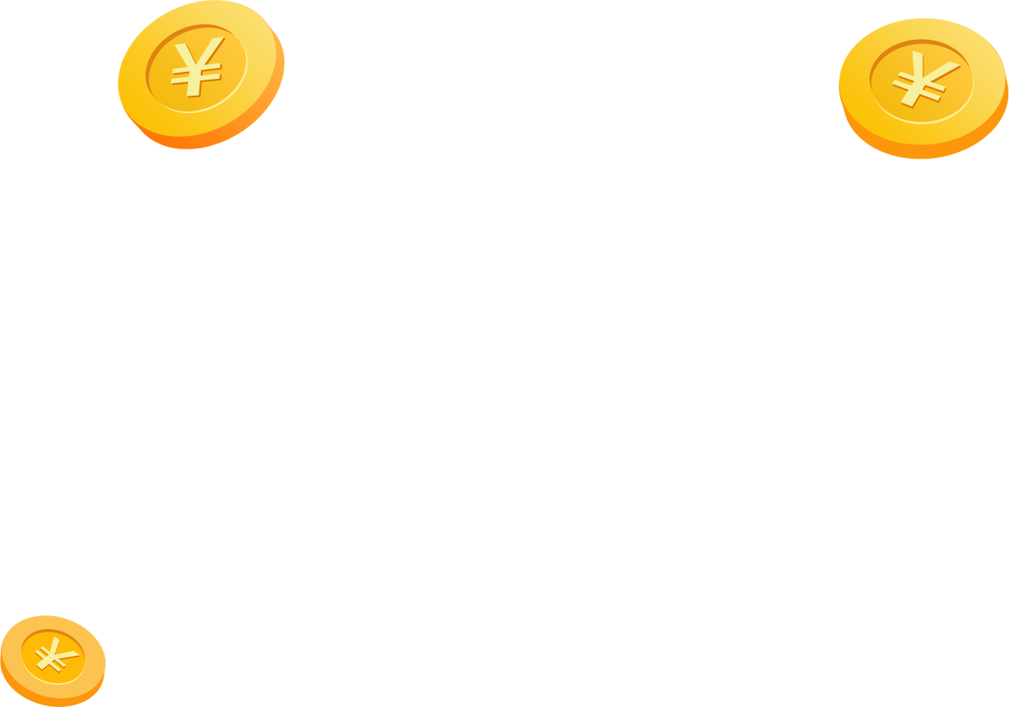




WiseInvest
Your Convenient Fund
Trading Assistant
2253220 Yang Boxuan
2253206 Han Mingyang
2252219 Guan Yongying
2250689 Yang Wenqing

Slide 2

Project Management Summary
01
Brief introduction
02
Summary of the biweekly reports and milestone meetings
03
Current status of the project(
04
Project Management Result Summary
Project Economics Analysis
04
Size estimation of the course project
05
Cost estimation of the course project
06
Economic evaluation of the course project

Slide 3

/01
Brief introduction

Slide 4



01
Brief introduction
Project Goal
Build a stable trading platform.
Enhance user experience with intelligent recommendations and customer service.
Market Observation
Current platforms provide subscription, redemption, and account management.
Gaps: Lack of personalized advice and real-time support.
Project Origin
WiseInvest is a fund trading platform designed for personal investors and fund companies. Focuses on delivering efficient, secure, and personalized trading services.

Slide 5



01
Brief introduction
Project Highlight
User-Oriented Features
System Administrators
Daily Settlement
Product Management
Data Monitoring
Individual Investors
Risk Identification
Fund Trading
Account Overview
Key Highlights
End-to-End Transaction Process: Supports complete trading workflow.
Personalized Services: Rule-based recommendations + AI-powered customer support.

Slide 6
/02
Summary of the biweekly reports and milestone meetings

Slide 7


02
Summary of the biweekly reports and milestone meetings
Biweekly Report 1(Mar 24–Apr 6)
01
02
Biweekly Report 2(Apr 7–Apr 20)
Achievements: Project initiation, requirements gathering, SRS drafting.
Key Deliverables: Project Plan, User Requirements Specification (SRS).
Achievements: UI design and system
architecture design.
Key Deliverables: UI diagrams, design document.
Biweekly Report 3(Apr 21–May 4)
03
04
Biweekly Report 4(May 5–May 18)
Achievements: Login, registration, and product browsing system development.
Key Deliverables: Frontend and backend integration, environment setup.
Achievements: Development of recommendation and AI customer support systems.
Key Deliverables: Core system modules, initial recommendation system.
Biweekly Report 5(May 19–June 1)
05
Achievements: Completed backend testing of AI support module and system integration.
Key Deliverables: Final system testing, user manual creation.

Slide 8
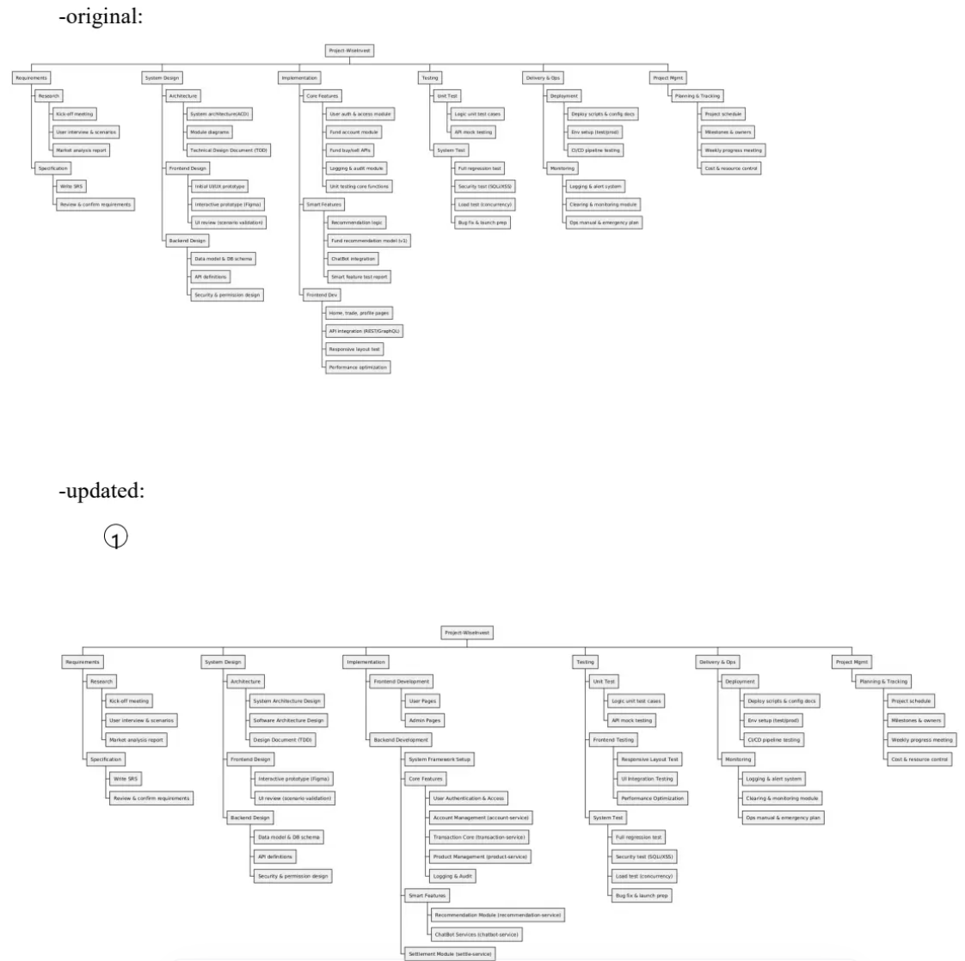
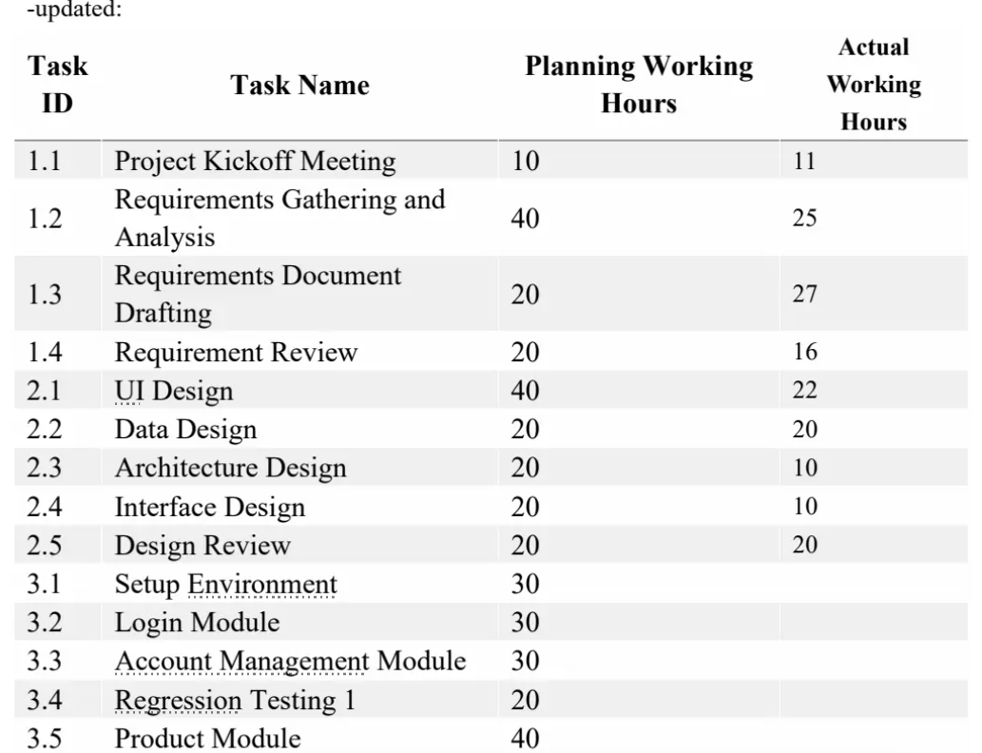
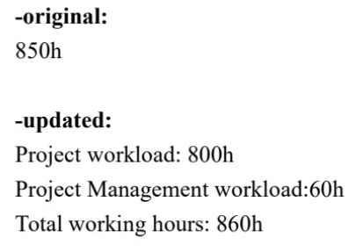
02
Milestone 1 Review(March 24-April 20)
Milestone 1 Achievements:
Completed:
Requirements analysis, UI design, and initial system architecture.
Developed login, registration, and product browsing pages.
Key Deliverables:
Project Plan, SRS draft, Functional prototype for login and registration.
Improvements Based on Feedback:
WBS
Planning working hours fofor each tasks
ToTotal working hours

Slide 9

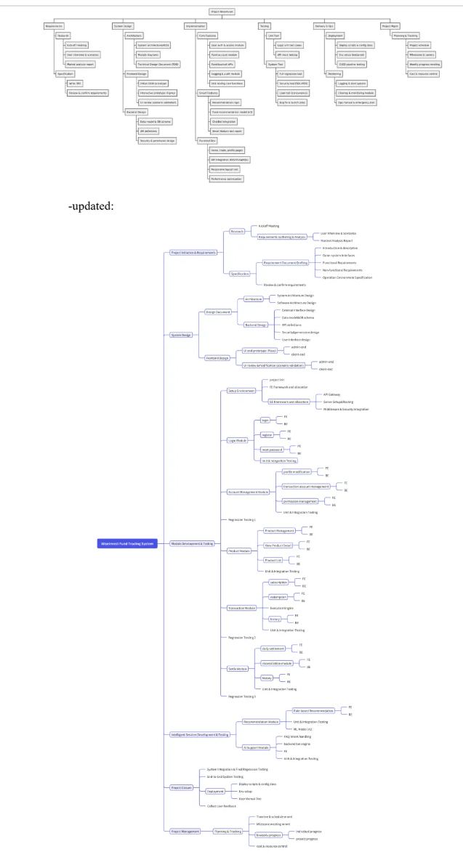
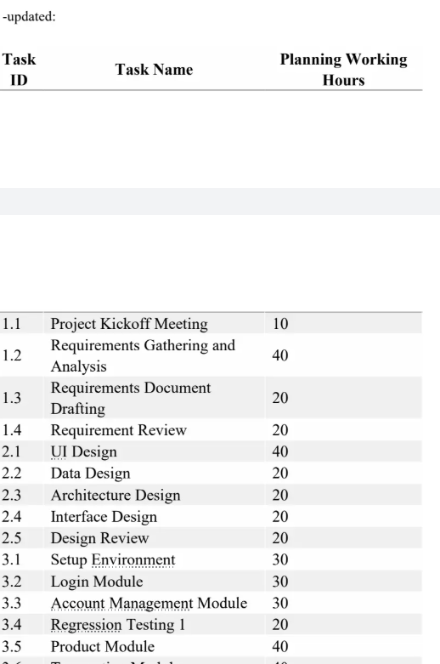
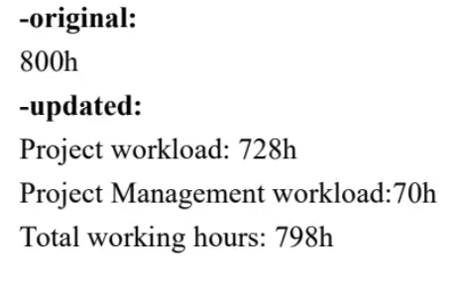

02
Milestone 2 Review(April 21-May 18)
Milestone 2 Achievements:
Completed:
Development of core modules (Account, Product, Transaction Services).
Unit testing and integration of core features.
Built initial components for AI recommendation and customer support.
Key Deliverables:
Core system functionalities (account management, product services).
Completed unit and integration tests for core features.
Improvements Based on Feedback:
WBS
Planning working hours fofor each tasks
oTotal working hours

Slide 10


/03
Current status of the project

Slide 11
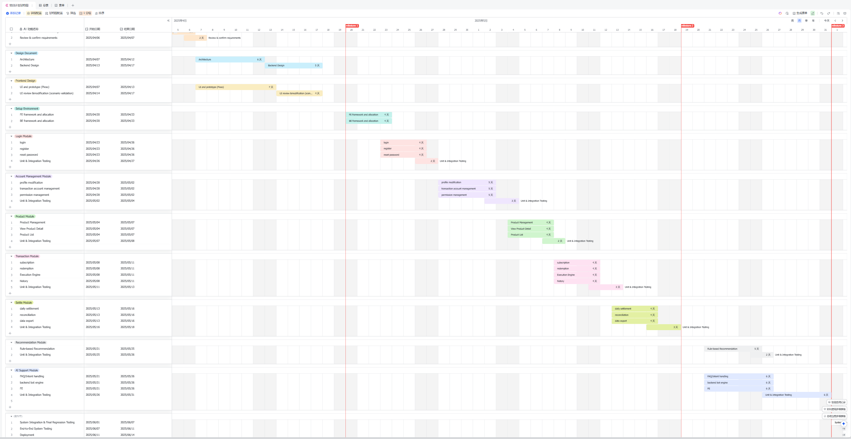

03
Current status of the project
Project Progress:100%
Functional Points Coverage:100%

Slide 12
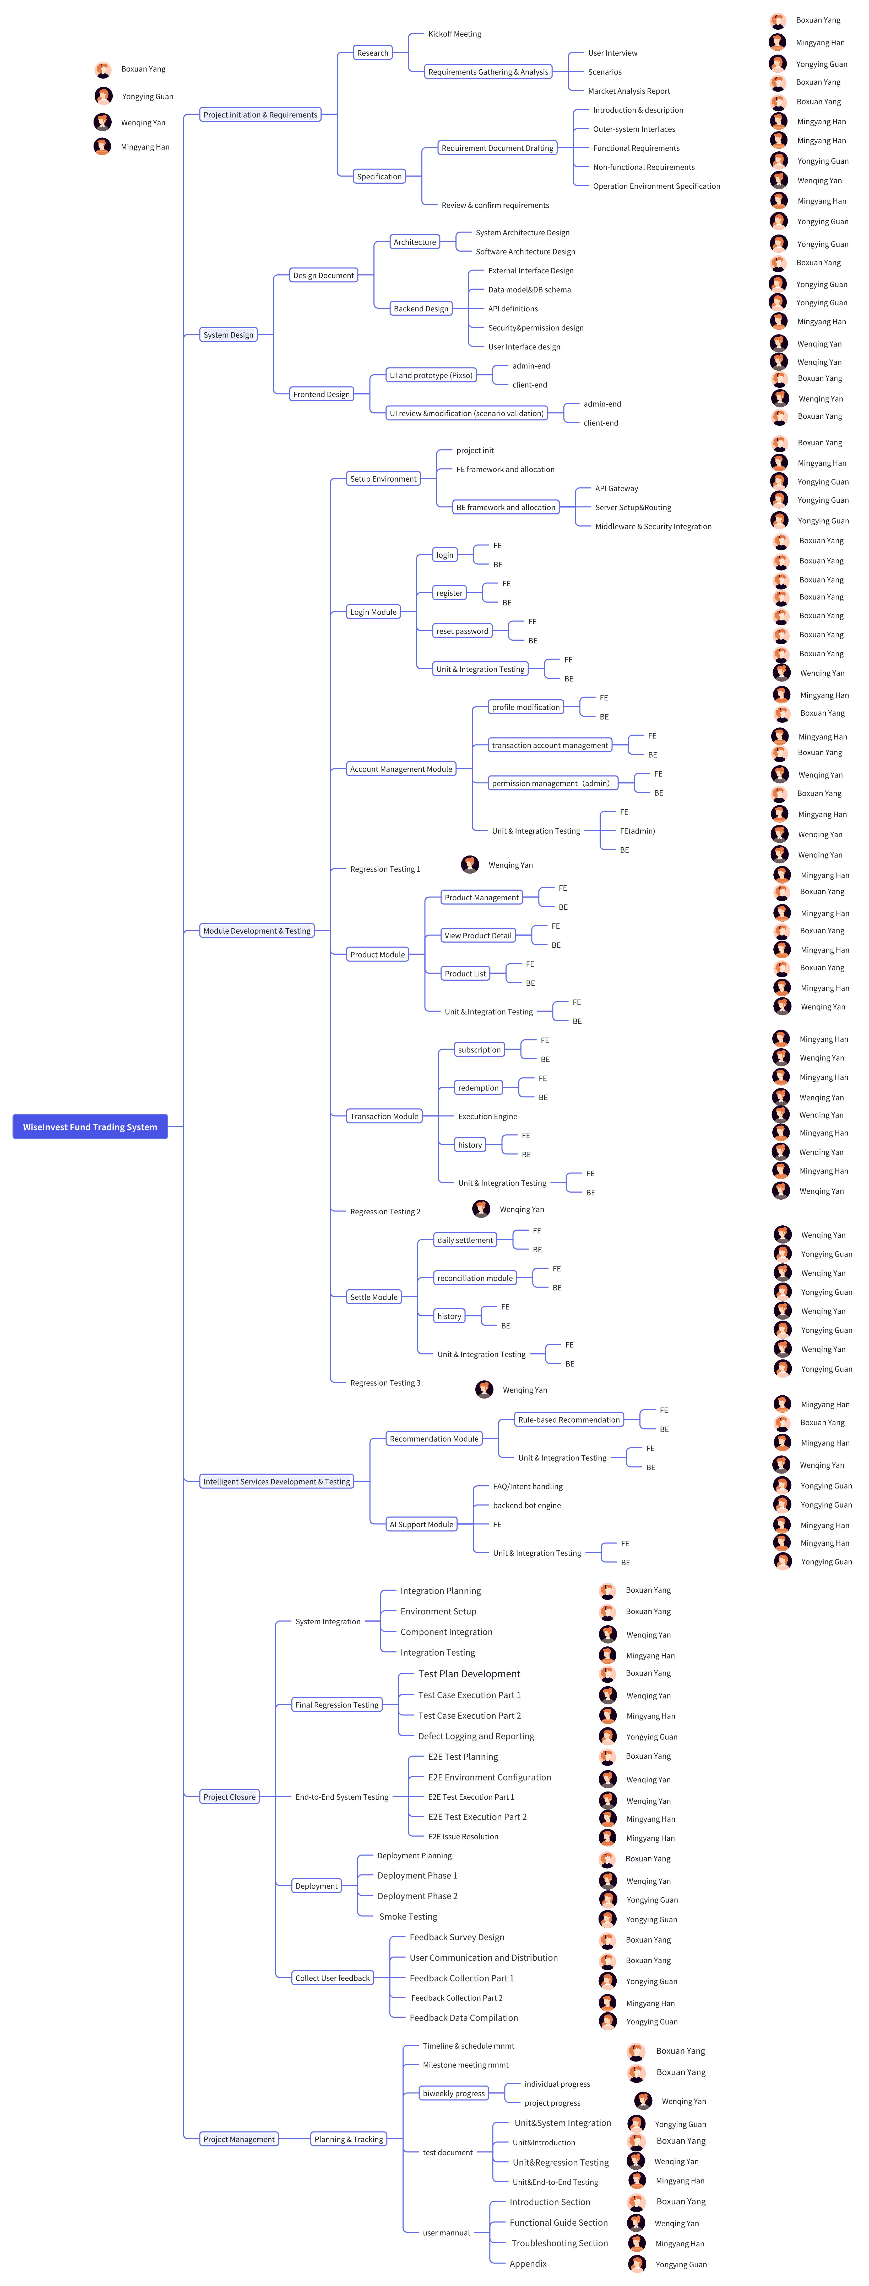
03
Current status of the project
Project Progress:100%
Functional Points Coverage:100%

Slide 13
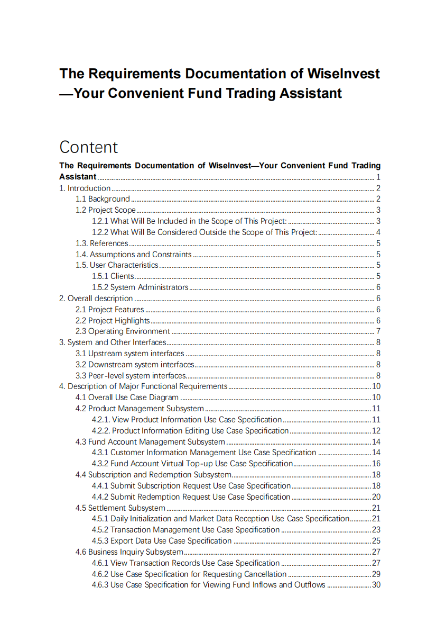
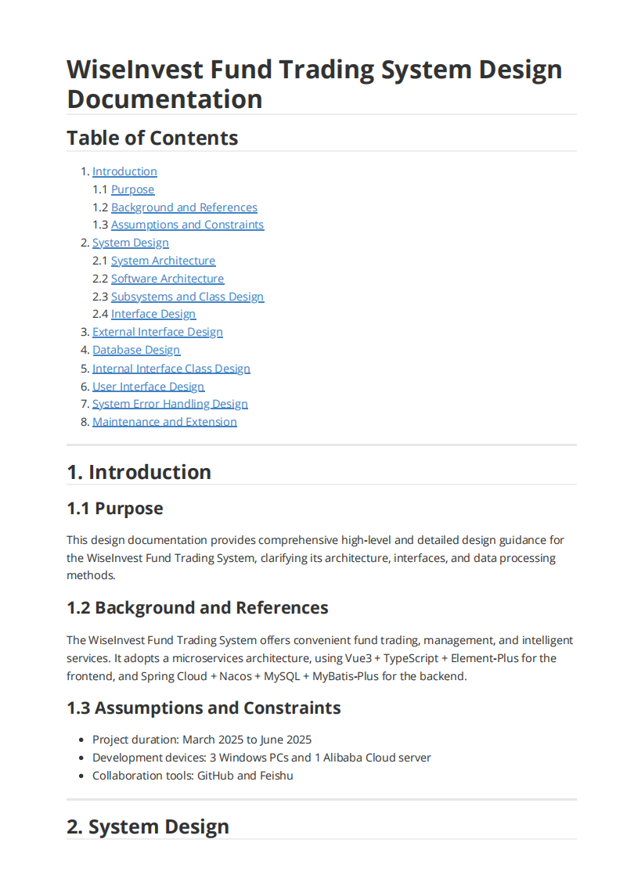
03
Current status of the project

Slide 14
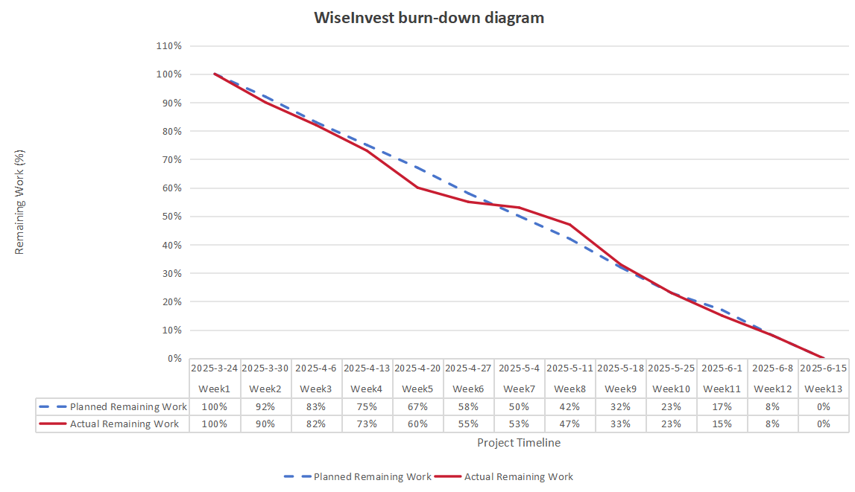
03
Current status of the project
Burn-down Chart
Our team was highly efficient during the requirements and initial design stages, putting our progress slightly ahead of schedule.
This was primarily due to the May Day national holiday. Although work was scheduled in the planning phase, the break meant that our actual output did not meet the planned expectations for that period.

Slide 15
03
Current status of the project
Earned Value Analysis
周末 (End of Week) | PV (计划价值) | EV (挣值) | AC (实际成本) | SV (进度偏差) | CPI (成本指数) | SPI (进度指数)
Week 1 | 12,763 | 15,954 | 12,086 | 3,191 | 1.32 | 1.25
Week 2 | 27,121 | 28,717 | 24,172 | 1,595 | 1.19 | 1.06
Week 3 | 39,884 | 43,075 | 36,258 | 3,191 | 1.19 | 1.08
Week 4 | 52,647 | 63,815 | 48,345 | 11,168 | 1.32 | 1.21
Week 5 | 66,906 | 71,792 | 60,431 | 4,886 | 1.19 | 1.07
Week 6 | 79,769 | 74,982 | 72,517 | -4,786 | 1.03 | 0.94
Week 7 | 92,531 | 84,555 | 84,603 | -7,977 | 1.00 | 0.91
Week 8 | 108,485 | 106,891 | 96,689 | -1,594 | 1.11 | 0.99
Week 9 | 122,849 | 122,849 | 108,775 | 0 | 1.13 | 1.00
Week 10 | 132,416 | 135,606 | 120,862 | 3,191 | 1.12 | 1.02
Week 11 | 146,774 | 146,774 | 132,948 | 0 | 1.10 | 1.00
Week 12 | 159,537 | 159,537 | 145,034 | 0 | 1.10 | 1.00
End of Week | PV | EV | AC | SV | CPI | SPI
Week 1 | 12,763 | 15,954 | 12,908 | 3,191 | 1.24 | 1.25
Week 2 | 27,121 | 28,717 | 25,815 | 1,595 | 1.11 | 1.06
Week 3 | 39,884 | 43,075 | 38,723 | 3,191 | 1.11 | 1.08
Week 4 | 52,647 | 63,815 | 51,630 | 11,168 | 1.24 | 1.21
Week 5 | 66,906 | 71,792 | 64,538 | 4,886 | 1.11 | 1.07
Week 6 | 79,769 | 74,982 | 77,445 | -4,786 | 0.97 | 0.94
Week 7 | 92,531 | 84,555 | 90,353 | -7,977 | 0.94 | 0.91
Week 8 | 108,485 | 106,891 | 103,260 | -1,594 | 1.03 | 0.99
Week 9 | 122,849 | 122,849 | 116,168 | 0 | 1.06 | 1.00
Week 10 | 132,416 | 135,606 | 129,075 | 3,191 | 1.05 | 1.02
Week 11 | 146,774 | 146,774 | 141,983 | 0 | 1.03 | 1.00
Week 12 | 159,537 | 159,537 | 154,890 | 0 | 1.03 | 1.00

Slide 16
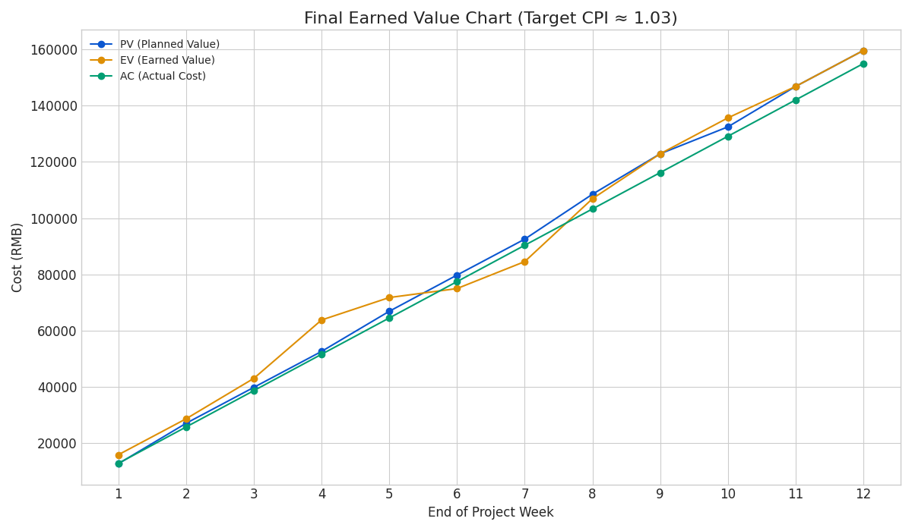
03
Current status of the project
Earned Value (PV, EV, AC) Chart
周末 (End of Week) | PV (计划价值) | EV (挣值) | AC (实际成本) | SV (进度偏差) | CPI (成本指数) | SPI (进度指数)
Week 1 | 12,763 | 15,954 | 12,086 | 3,191 | 1.32 | 1.25
Week 2 | 27,121 | 28,717 | 24,172 | 1,595 | 1.19 | 1.06
Week 3 | 39,884 | 43,075 | 36,258 | 3,191 | 1.19 | 1.08
Week 4 | 52,647 | 63,815 | 48,345 | 11,168 | 1.32 | 1.21
Week 5 | 66,906 | 71,792 | 60,431 | 4,886 | 1.19 | 1.07
Week 6 | 79,769 | 74,982 | 72,517 | -4,786 | 1.03 | 0.94
Week 7 | 92,531 | 84,555 | 84,603 | -7,977 | 1.00 | 0.91
Week 8 | 108,485 | 106,891 | 96,689 | -1,594 | 1.11 | 0.99
Week 9 | 122,849 | 122,849 | 108,775 | 0 | 1.13 | 1.00
Week 10 | 132,416 | 135,606 | 120,862 | 3,191 | 1.12 | 1.02
Week 11 | 146,774 | 146,774 | 132,948 | 0 | 1.10 | 1.00
Week 12 | 159,537 | 159,537 | 145,034 | 0 | 1.10 | 1.00
The AC curve finishes just slightly below the EV curve. This visually demonstrates that the project was completed with excellent fiscal discipline, resulting in a modest but important cost saving.

Slide 17
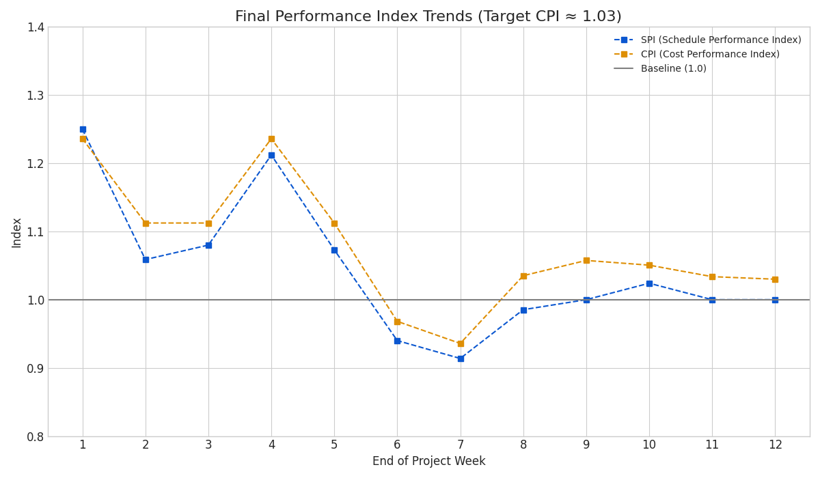
03
Current status of the project
Earned Value (PV, EV, AC) Chart
周末 (End of Week) | PV (计划价值) | EV (挣值) | AC (实际成本) | SV (进度偏差) | CPI (成本指数) | SPI (进度指数)
Week 1 | 12,763 | 15,954 | 12,086 | 3,191 | 1.32 | 1.25
Week 2 | 27,121 | 28,717 | 24,172 | 1,595 | 1.19 | 1.06
Week 3 | 39,884 | 43,075 | 36,258 | 3,191 | 1.19 | 1.08
Week 4 | 52,647 | 63,815 | 48,345 | 11,168 | 1.32 | 1.21
Week 5 | 66,906 | 71,792 | 60,431 | 4,886 | 1.19 | 1.07
Week 6 | 79,769 | 74,982 | 72,517 | -4,786 | 1.03 | 0.94
Week 7 | 92,531 | 84,555 | 84,603 | -7,977 | 1.00 | 0.91
Week 8 | 108,485 | 106,891 | 96,689 | -1,594 | 1.11 | 0.99
Week 9 | 122,849 | 122,849 | 108,775 | 0 | 1.13 | 1.00
Week 10 | 132,416 | 135,606 | 120,862 | 3,191 | 1.12 | 1.02
Week 11 | 146,774 | 146,774 | 132,948 | 0 | 1.10 | 1.00
Week 12 | 159,537 | 159,537 | 145,034 | 0 | 1.10 | 1.00
The CPI and SPI starts strong, but it dips to just under 1.0 during weeks 6 and 7. This accurately reflects the slightly increased cost associated with getting the schedule back on track.
The key takeaway is that our team quickly corrected this, bringing the CPI back above 1.0 for the remainder of the project.

Slide 18
/04
Project Management Result Summary

Slide 19
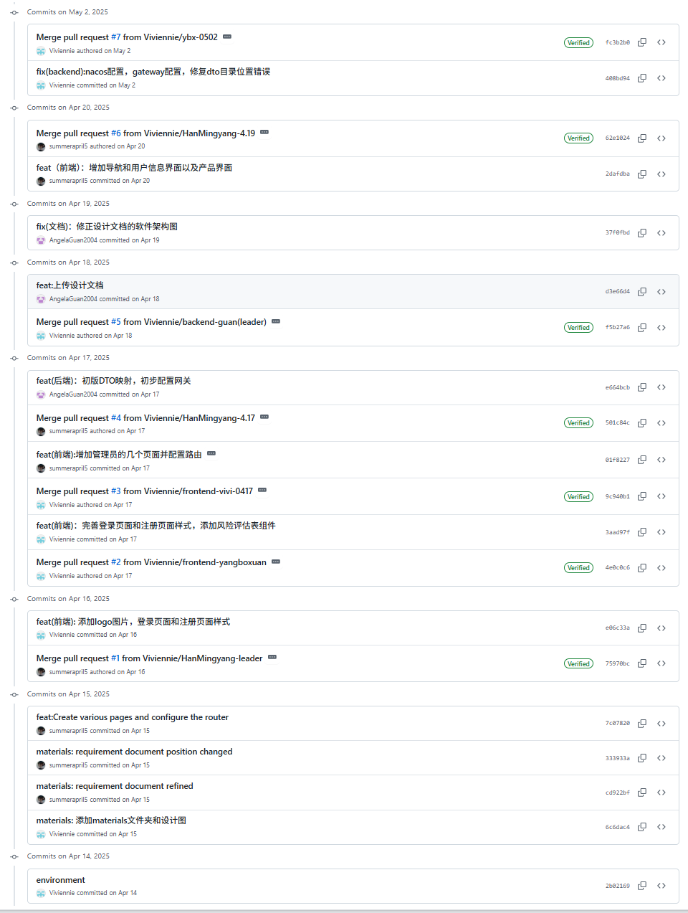
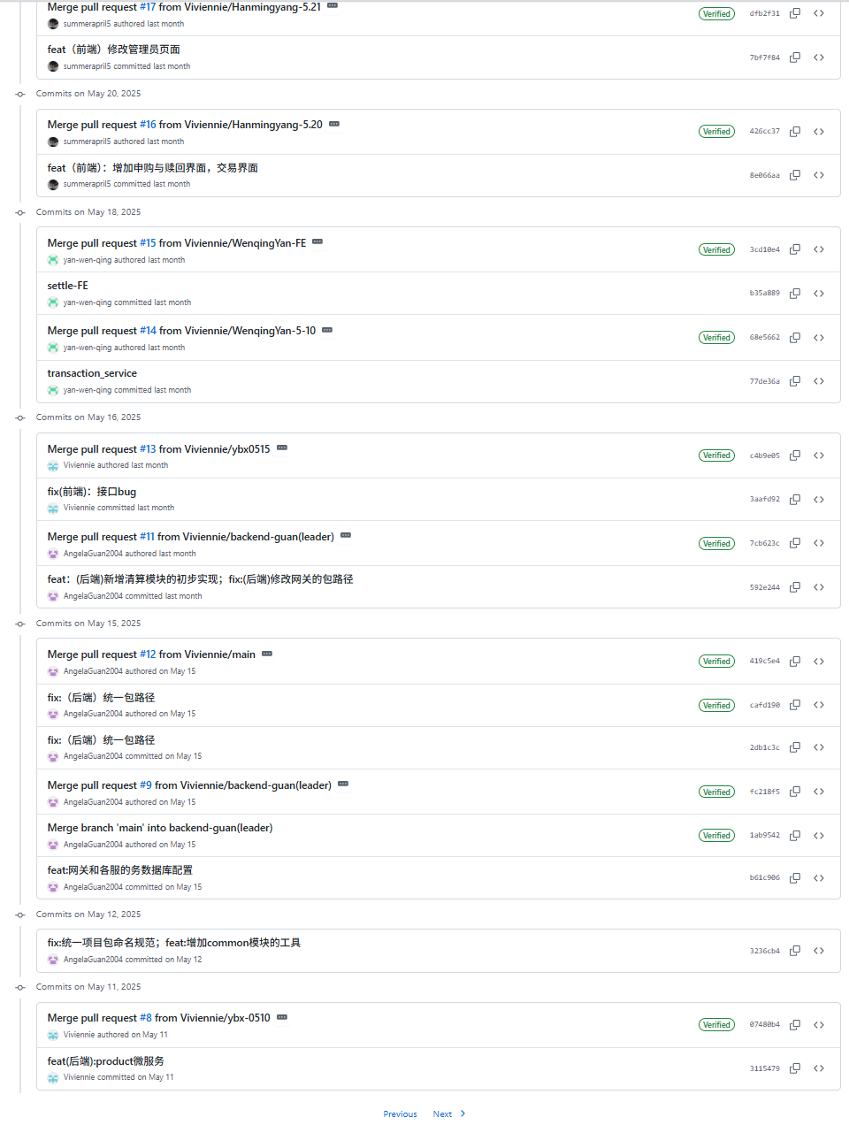
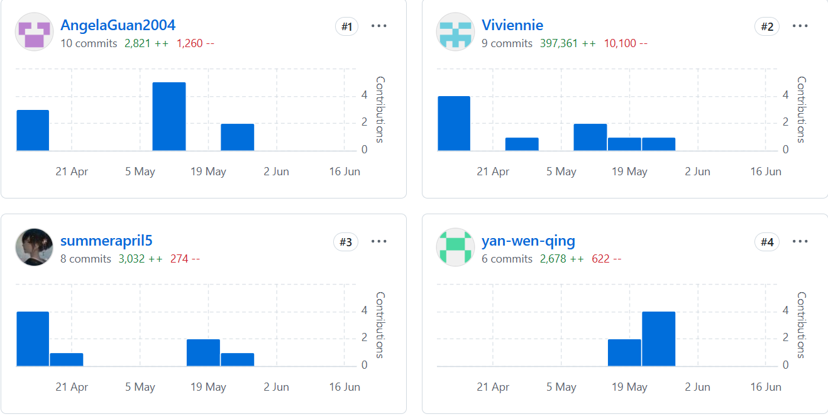
04
Project Management Result Summary
During the development phase, 4 authors have pushed 54 commits to all branches.

Slide 20
04
Project Management Result Summary
Name | Module | Task | Actual Working Hours | Planning Working Hours
Boxuan Yang | Project initiation & Requirements | Kickoff Meeting | 11 | 10
 |  | Marcket Analysis Report | 5 | 5
 |  | RD——Introduction & description | 5.4 | 5.4
 | Design Document | Software Architecture Design | 8.5 | 8.5
 | Frontend Design | client-end | 15 | 20
 | Setup Environment | project init | 5 | 5
 | Login Module | FE BE Test(FE) | 21 | 18
 | Account Management Module | BE | 10 | 10
 | Product Module | BE | 15 | 20
 | Recommendation Module | BE | 20 | 20
 | System Integration | Integration Planning&Environment Setup | 5 | 5
 | Final Regression Testing | Test Plan Development | 2 | 2
 | End-to-End System Testing | E2E Test Planning | 3 | 7
 | Deployment | Deployment Planning | 7 | 10
 | Collect User feedback | Feedback Survey Design&User Communication and Distribution | 10 | 10
 | User Mannual | Introduction Section | 7.5 | 7.5
 | Test Document | Unit&Introduction | 4 | 4
 | Project Management | Supervision&Allocation & milestone summary | 27.5 | 17.5
 |  |  | 181.9 | 194.9
Name | Module | Task | Actual Working Hours | Planning Working Hours
Wenqing Yan | Project initiation & Requirements | Operation Environment Specification | 5.4 | 5.4
 | Design Document | User Interface design | 8.5 | 8.5
 | Frontend Design | admin-end | 10 | 20
 | Login Module | Test(BE) | 5 | 5
 | Account Management Module | Test(BE) | 3 | 5
 | Regression Testing 1 | Regression Testing | 6 | 20
 | Product Module | Test(BE) | 7 | 5
 | Transaction Module | BE ,Test(BE) | 28 | 20
 | Regression Testing 2 | Regression Testing | 6 | 8
 | Settle Module | FE ,Test(FE) | 13 | 20
 | Regression Testing 3 | Regression Testing | 10 | 10
 | Recommendation Module | Test(BE) | 5 | 5
 | System Integration | Component Integration | 5 | 5
 | Final Regression Testing | Test Case Execution Part 1 | 5 | 5
 | End-to-End System Testing | E2E Environment Configuration&E2E Test Execution Part 1 | 7 | 10
 | Deployment | Deployment Phase 1 | 4 | 5
 | User Mannual | Functional Guide Section | 7.5 | 7.5
 | Test DOcument | Unit&Regression Testing | 13 | 13
 | Project Management | individual biweekly report &project progress report | 17.5 | 17.5
 |  |  | 175.9 | 194.9

Slide 21
04
Project Management Result Summary
Name | Module | Task | Actual Working Hours | Planning Working Hours
Mingyang Han | Project initiation & Requirements | User Interview | 10 | 10
 |  | RD——Outer-system Interfaces & Functional Requirements | 10.8 | 10.8
 |  | Review & confirm requirements | 22 | 20
 | Design Document | API definitions | 8.5 | 8.5
 | Setup Environment | FE framework and allocation | 10 | 10
 | Account Management Module | FE,Test(FE) | 14 | 20
 | Product Module | FE,Test(FE) | 20 | 20
 | Transaction ModuleTransaction Module | FE,Test(FE) | 16 | 20
 | Recommendation Module | FE,Test(FE) | 13 | 20
 | AI Support Module | FE,Test(FE) | 18 | 25
 | System Integration | Integration Testing | 5 | 5
 | Final Regression Testing | Test Case Execution Part 2 | 5 | 5
 | End-to-End System Testing | E2E Test Execution Part 2&E2E Issue Resolution | 10 | 10
 | User Feedback | Feedback Collection Part 1 | 2 | 5
 | User Mannual | Troubleshooting Section | 2.5 | 7.5
 | Test Document | Unit&End-to-End Testing | 9 | 9
 | Project Management | individual biweekly report & ppt preparation(SEE) | 1.5 | 17.5
 |  |  | 178.8 | 197.3
Name | Module | Task | Actual Working Hours | Planning Working Hours
Yongying Guan | Project initiation & Requirements | Scenarios | 10 | 10
 |  | Non-functional Requirements | 5.4 | 5.4
 | Design Document | System Architecture Design | 8.5 | 8.5
 |  | BD-External Interface Design&Data model&DB schema | 17 | 17
 | Setup Environment | BE framework and allocation | 15 | 15
 | Settle Module | BE,Test(BE) | 24 | 20
 | AI Support Module | BE,Test(BE) | 30 | 25
 | Final Regression Testing | Defect Logging and Reporting | 5 | 5
 | Deployment | Deployment Phase 2& Smoke Testing | 10 | 10
 | Collect User feedback | Feedback Collection Part 1 | 8 | 10
 |  | Feedback Data Compilation | 7 | 5
 | User Mannual | Appendix | 13.5 | 15.5
 | Test Document | Unit&System Integration | 5 | 5
 | Project Management | individual biweekly report & milestone ppt preparation | 19.5 | 17.5
 |  |  | 177.9 | 188.9

Slide 22
04
Project Management Result Summary
Total Working Hours Dimension | Total Planning working hours | Labor Efficiency Rate
 | 798h
 | Total Actual working hours | 112%
 | 181.9+175.9+178.8+177.9=714.5h
Total Task Points Dimension | Planning Task Points | Task Completion Rate
 | 114
 | Actual Task Points Completion | 100%
 | 114

Slide 23
/05
Size estimation of the course project

Slide 24
05
Size estimation of the course project
EIF Name | DETs Count | RETs Count | Complexity | UFP
EIF1: Data_Center_Market_Data | 4 | 1 | Low | 5
EIF Subtotal |  |  |  | 5
ILF Name | DETs Count | RETs Count | Complexity | UFP
ILF1: Customer_Info | 4 | 1 | Low | 7
ILF2: Admin_Info | 4 | 1 | Low | 7
ILF3: Trading_Account_Info | 6 | 1 | Low | 7
ILF4: Bankcard_Info | 5 | 1 | Low | 7
ILF5: Product_Info | 5 | 1 | Low | 7
ILF6: NetValue_Info | 3 | 1 | Low | 7
ILF7: System_Status_Info | 3 | 1 | Low | 7
ILF8: Subscription_Records | 5 | 1 | Low | 7
ILF9: Redemption_Records | 6 | 1 | Low | 7
ILF10: Holding_Info | 6 | 1 | Low | 7
ILF11: Transaction_Log | 9 | 1 | Low | 7
ILF12: Recommendation_Log | 5 | 1 | Low | 7
ILF13: Chatbot_Query_Log | 5 | 1 | Low | 7
ILF14: Knowledge_Base | 7 | 1 | Low | 7
ILF Subtotal |  |  |  | 98
Function Name | Type | DETs Count | FTRs Count | Complexity | UFP
EO1: List Products | EO | 10 | 1 | Average | 5
EO2: Trading Record Query Display | EO | 15 | 2 | Average | 5
EO3: Settlement Data Export | EO | 25 | 4 | High | 7
EO4: Recommendation Display | EO | 8 | 2 | Average | 5
EO5: Chatbot Response | EO | 2 | 2 | Low | 4
EO6: Upload Data to Data Center | EO | 25 | 4 | High | 7
EO7: Transaction Confirmation | EO | 4 | 1 | Low | 4
EO8: Process Payment/Refund | EO | 6 | 1 | Average | 5
EO Subtotal |  |  |  |  | 42

Slide 25
05
Size estimation of the course project
Function Name | Type | DETs Count | FTRs Count | Complexity | UFP
EI1: Create Customer Account | EI | 10 | 3 | High | 6
EI2: Update Customer Risk Assessment | EI | 2 | 1 | Low | 3
EI3: Manage Bankcard | EI | 5 | 2 | Average | 4
EI4: User/Admin Login | EI | 3 | 1 | Low | 3
EI5: Update Password | EI | 4 | 1 | Low | 3
EI6: Add Product | EI | 4 | 1 | Low | 3
EI7: Edit Product | EI | 5 | 1 | Low | 3
EI8: Subscribe/Redeem Fund | EI | 4 | 4 | High | 6
EI9: Cancel Order | EI | 2 | 2 | Low | 3
EI10: Daily Initialization | EI | 2 | 1 | Low | 3
EI11: Receive Market Data | EI | 3 | 2 | Low | 3
EI12: User Inquiry to Chatbot | EI | 2 | 2 | Low | 3
EI13: Knowledge Base Update | EI | 6 | 1 | Low | 3
EI14: Algorithm Optimization Input | EI | 4 | 1 | Low | 3
EI15: Verify SMS Code | EI | 2 | 0 | Low | 3
EI Subtotal |  |  |  |  | 52
Function Name | Type | DETs Count | FTRs Count | Complexity | UFP
EQ1: View Customer Account Details | EQ | 8 | 3 | Average | 4
EQ2: View Product Details | EQ | 10 | 2 | Average | 4
EQ3: View Current Holdings | EQ | 10 | 2 | Average | 4
EQ4: Get System Status | EQ | 2 | 1 | Low | 3
EQ Subtotal |  |  |  |  | 15

Slide 26
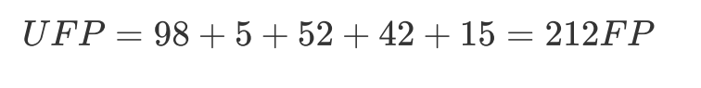
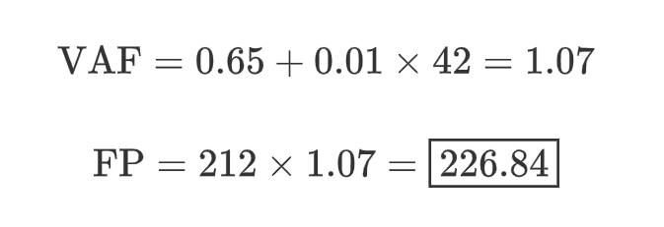
05
Size estimation of the course project
Function Type | Count | Total UFP
ILF | 14 | 98
EIF | 1 | 5
EI | 15 | 52
EO | 8 | 42
EQ | 4 | 15
Total UFP | 42 | 212
GSC ID | Characteristic | Score
1 | Data Communications | 4
2 | Distributed Processing | 3
3 | Performance | 4
4 | Heavily Used Configuration | 2
5 | Transaction Rate | 4
6 | Online Data Entry | 4
7 | End User Efficiency | 3
8 | Online Update | 4
9 | Complex Processing | 4
10 | Reusability | 3
11 | Installation Ease | 2
12 | Operational Ease | 3
13 | Multiple Sites | 2
14 | Facilitate Change | 3
Total |  | 42
UFP
GSC

Slide 27
/06
Cost estimation of the course project

Slide 28
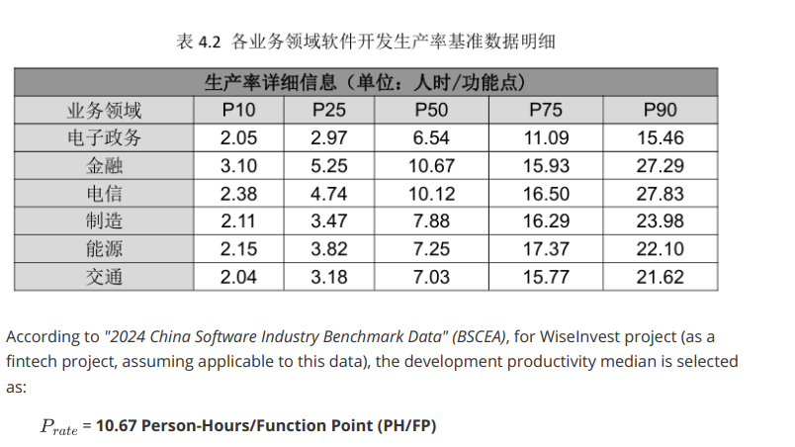
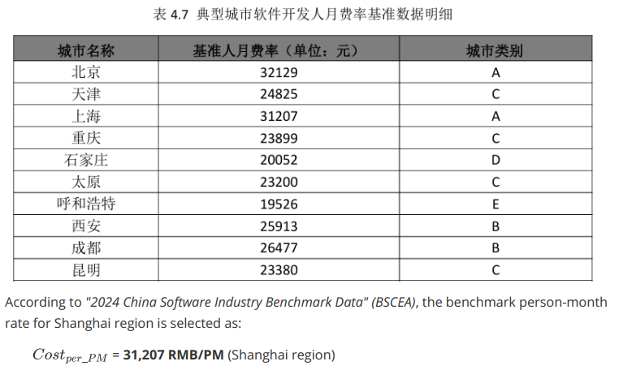
06
Cost estimation of the course project
Estimation Method: Function Point–based parametric model
(GB/T 36964-2018 + BSCEA 2024 benchmarks)
Function Points: 226.84 FP (IFPUG adjusted)
Productivity: 10.67 person-hours per FP
Total Effort: ≈ 2420.39 person-hours
Person-Months: ≈ 13.45 PM (180 hours/month)
Labor Rate: ¥31,207 per PM (Shanghai)
Estimated Cost: ≈ ¥419,623

Slide 29
/07
Economic evaluation of the course project

Slide 30
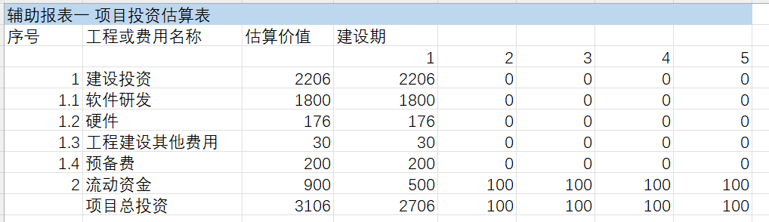
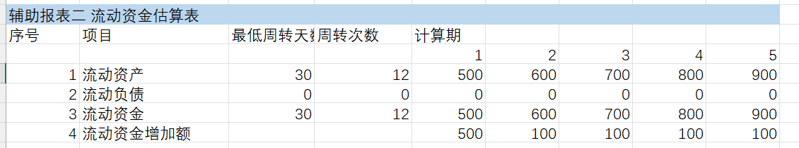
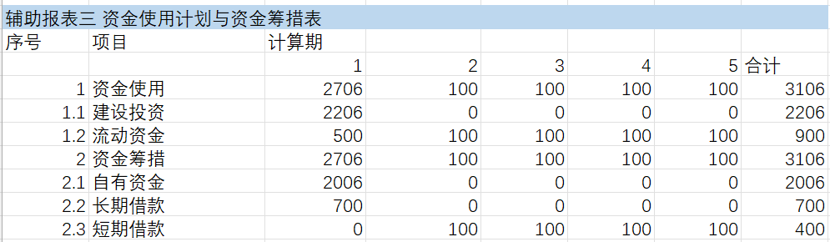
07
Economic evaluation of the course project
Project Investment Estimate Table
Working Capital Estimate Table
Funding Utilization and
Fund Raising Plan Table

Slide 31
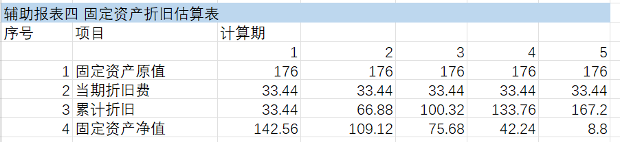
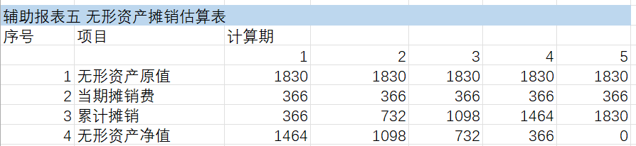
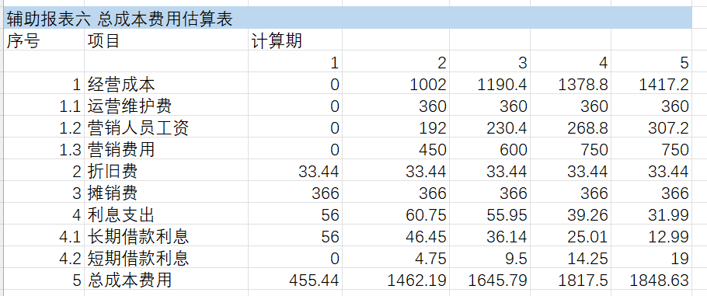
07
Economic evaluation of the course project
Depreciation Estimate of Fixed Assets Table
Amortization Estimate of
Intangible Assets Table
Total Cost and Expense Estimate Table

Slide 32
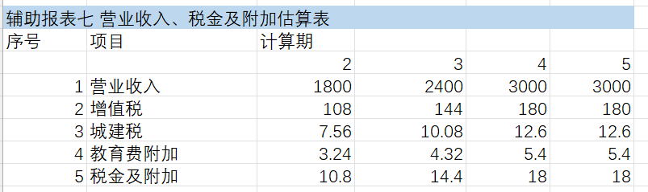
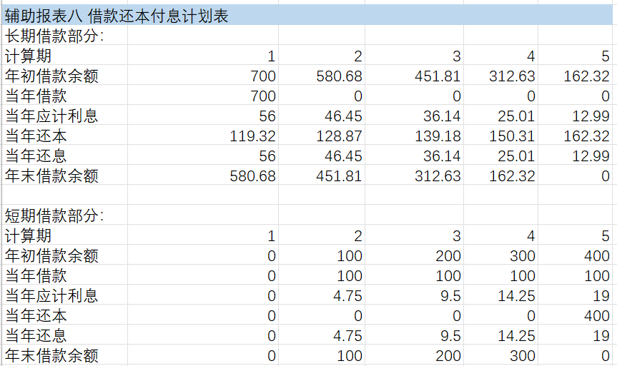
07
Economic evaluation of the course project
Operating Revenue,
Tax and Surcharges Estimation Table
Loan Repayment and Interest Payment Plan Table

Slide 33
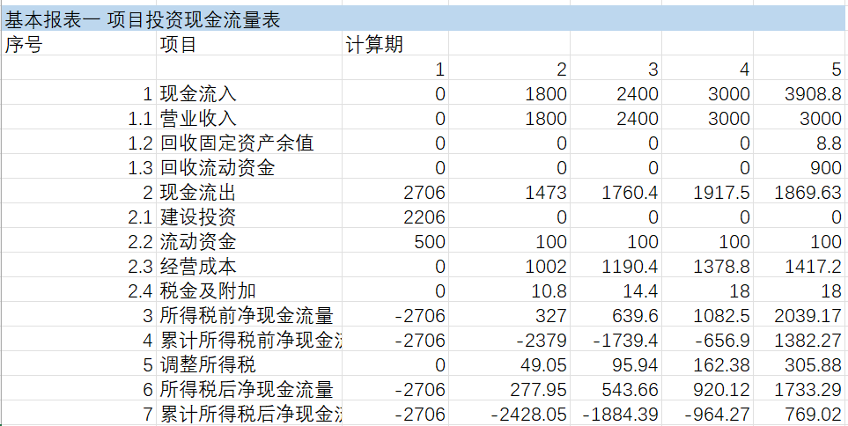
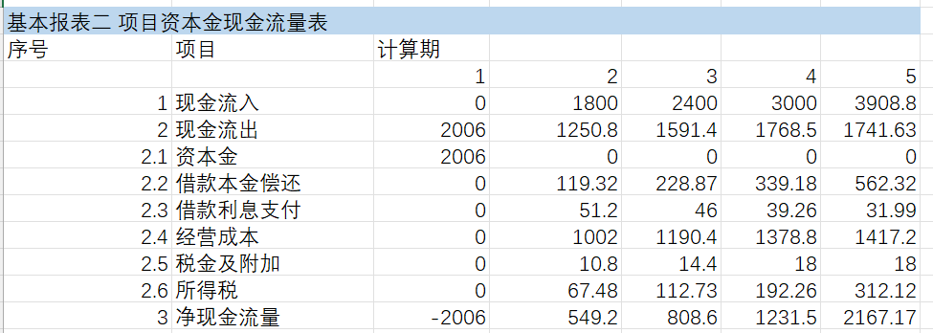
07
Economic evaluation of the course project
Project Investment Cash Flow Statement
Project Equity Cash Flow Statement

Slide 34
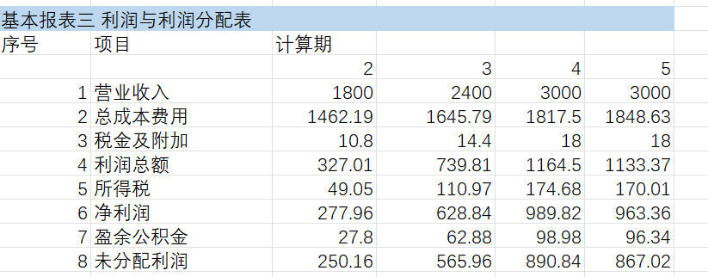
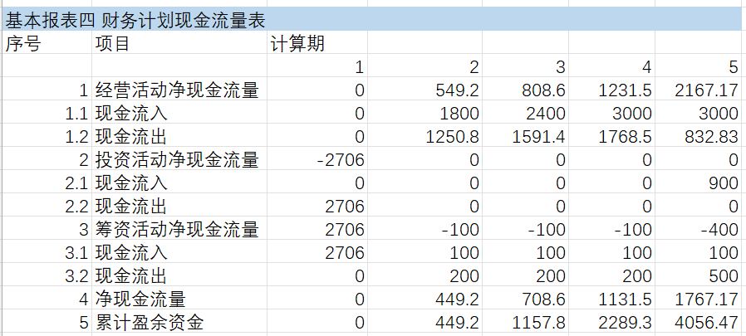
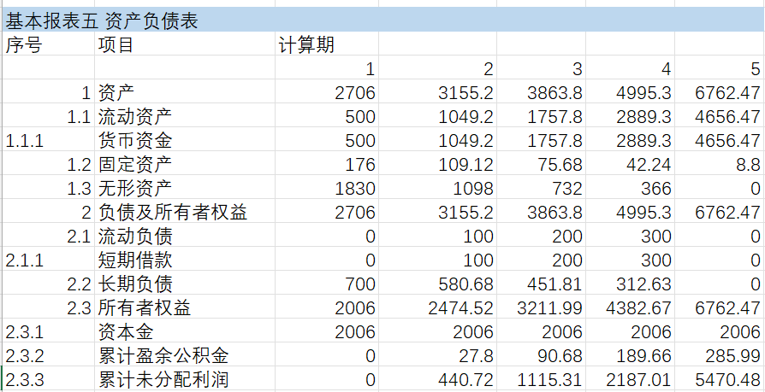
07
Economic evaluation of the course project
Profit and Profit Distribution Statement
Financial Plan Cash Flow Statement
Balance Sheet

Slide 35

WiseInvest
Thank you !
2253220 Yang Boxuan
2253206 Han Mingyang
2252219 Guan Yongying
2250689 Yang Wenqing

